Slide 1
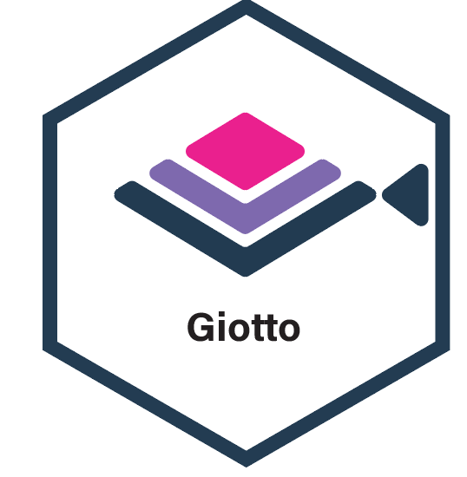
Giotto Suite: Analysis Setup and Initial Workflows
Spatial Transcriptomics Working Group
Dec 4 2025
Jiaji George Chen
jiajic@bu.edu

Slide 2

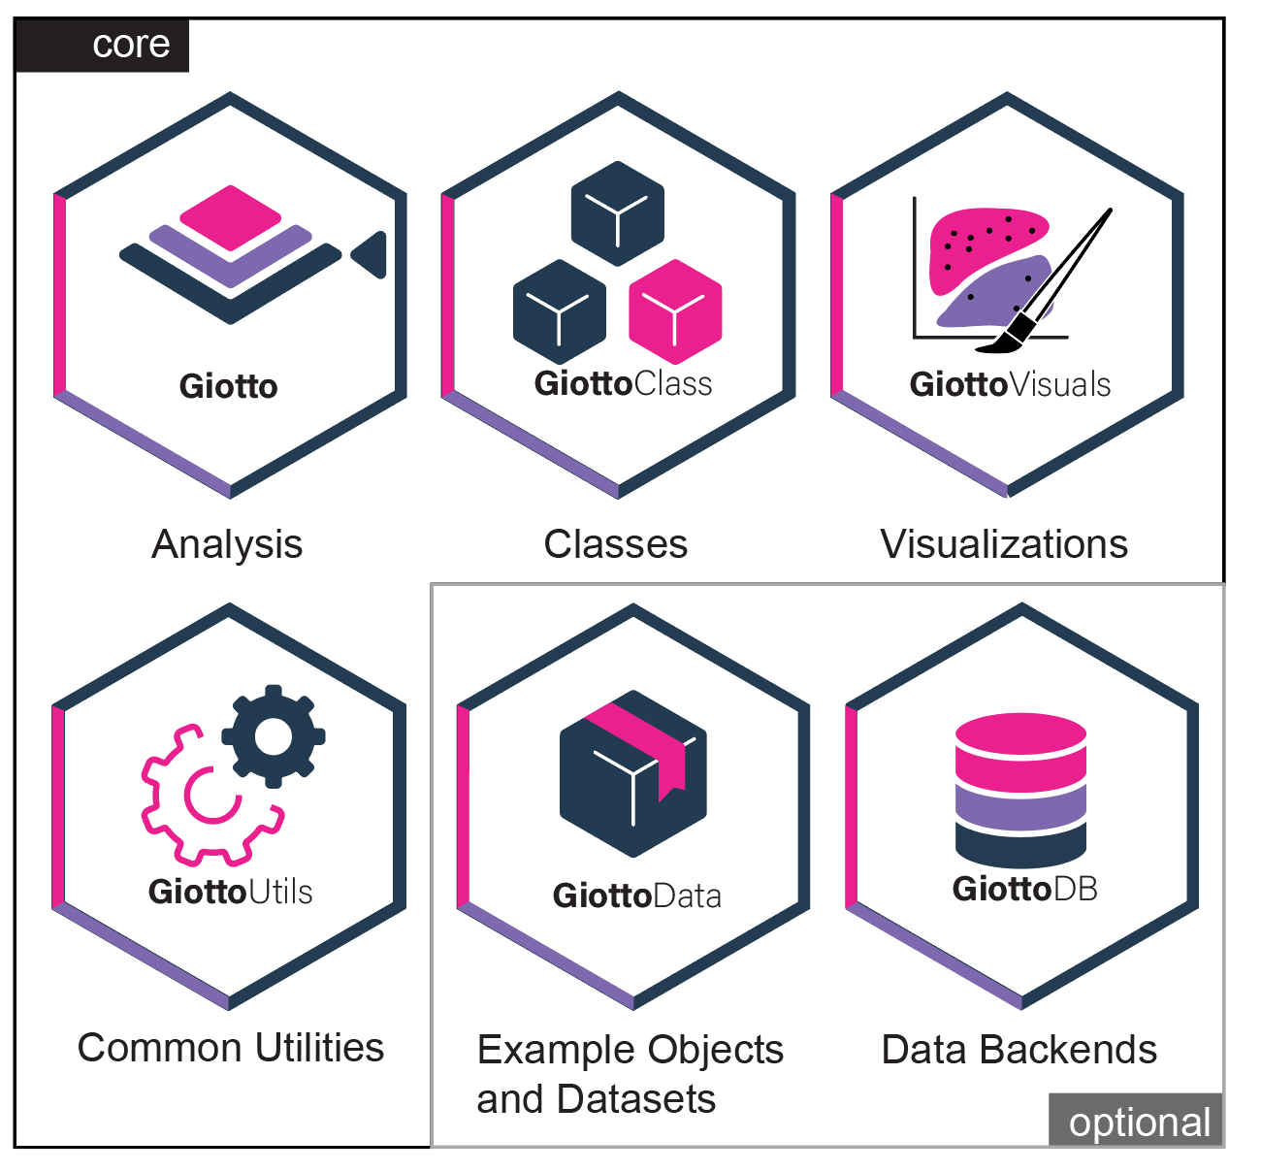
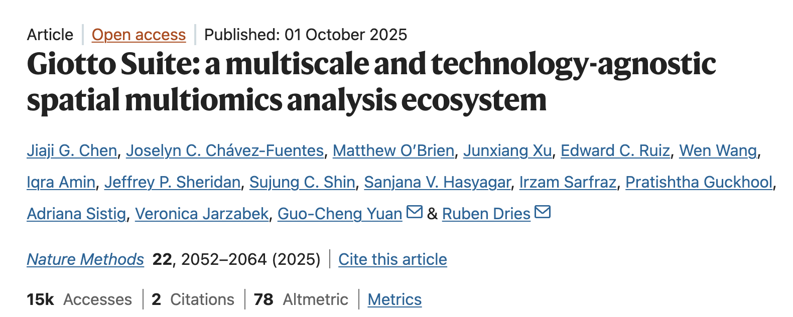
For more examples and tutorials: giottosuite.com
Notes:
Ecosystem of R packages main packages are GiottoClass and Giotto for covering both data structure representations for spatialomics data and analysis methods.
Recently published this tool in Nature Methods. Both the paper and the website giottosuite.com contain lots of additional examples and explanations
Start with hows and whys of Giotto Suite then move to a quick demo with Xenium data

Slide 3
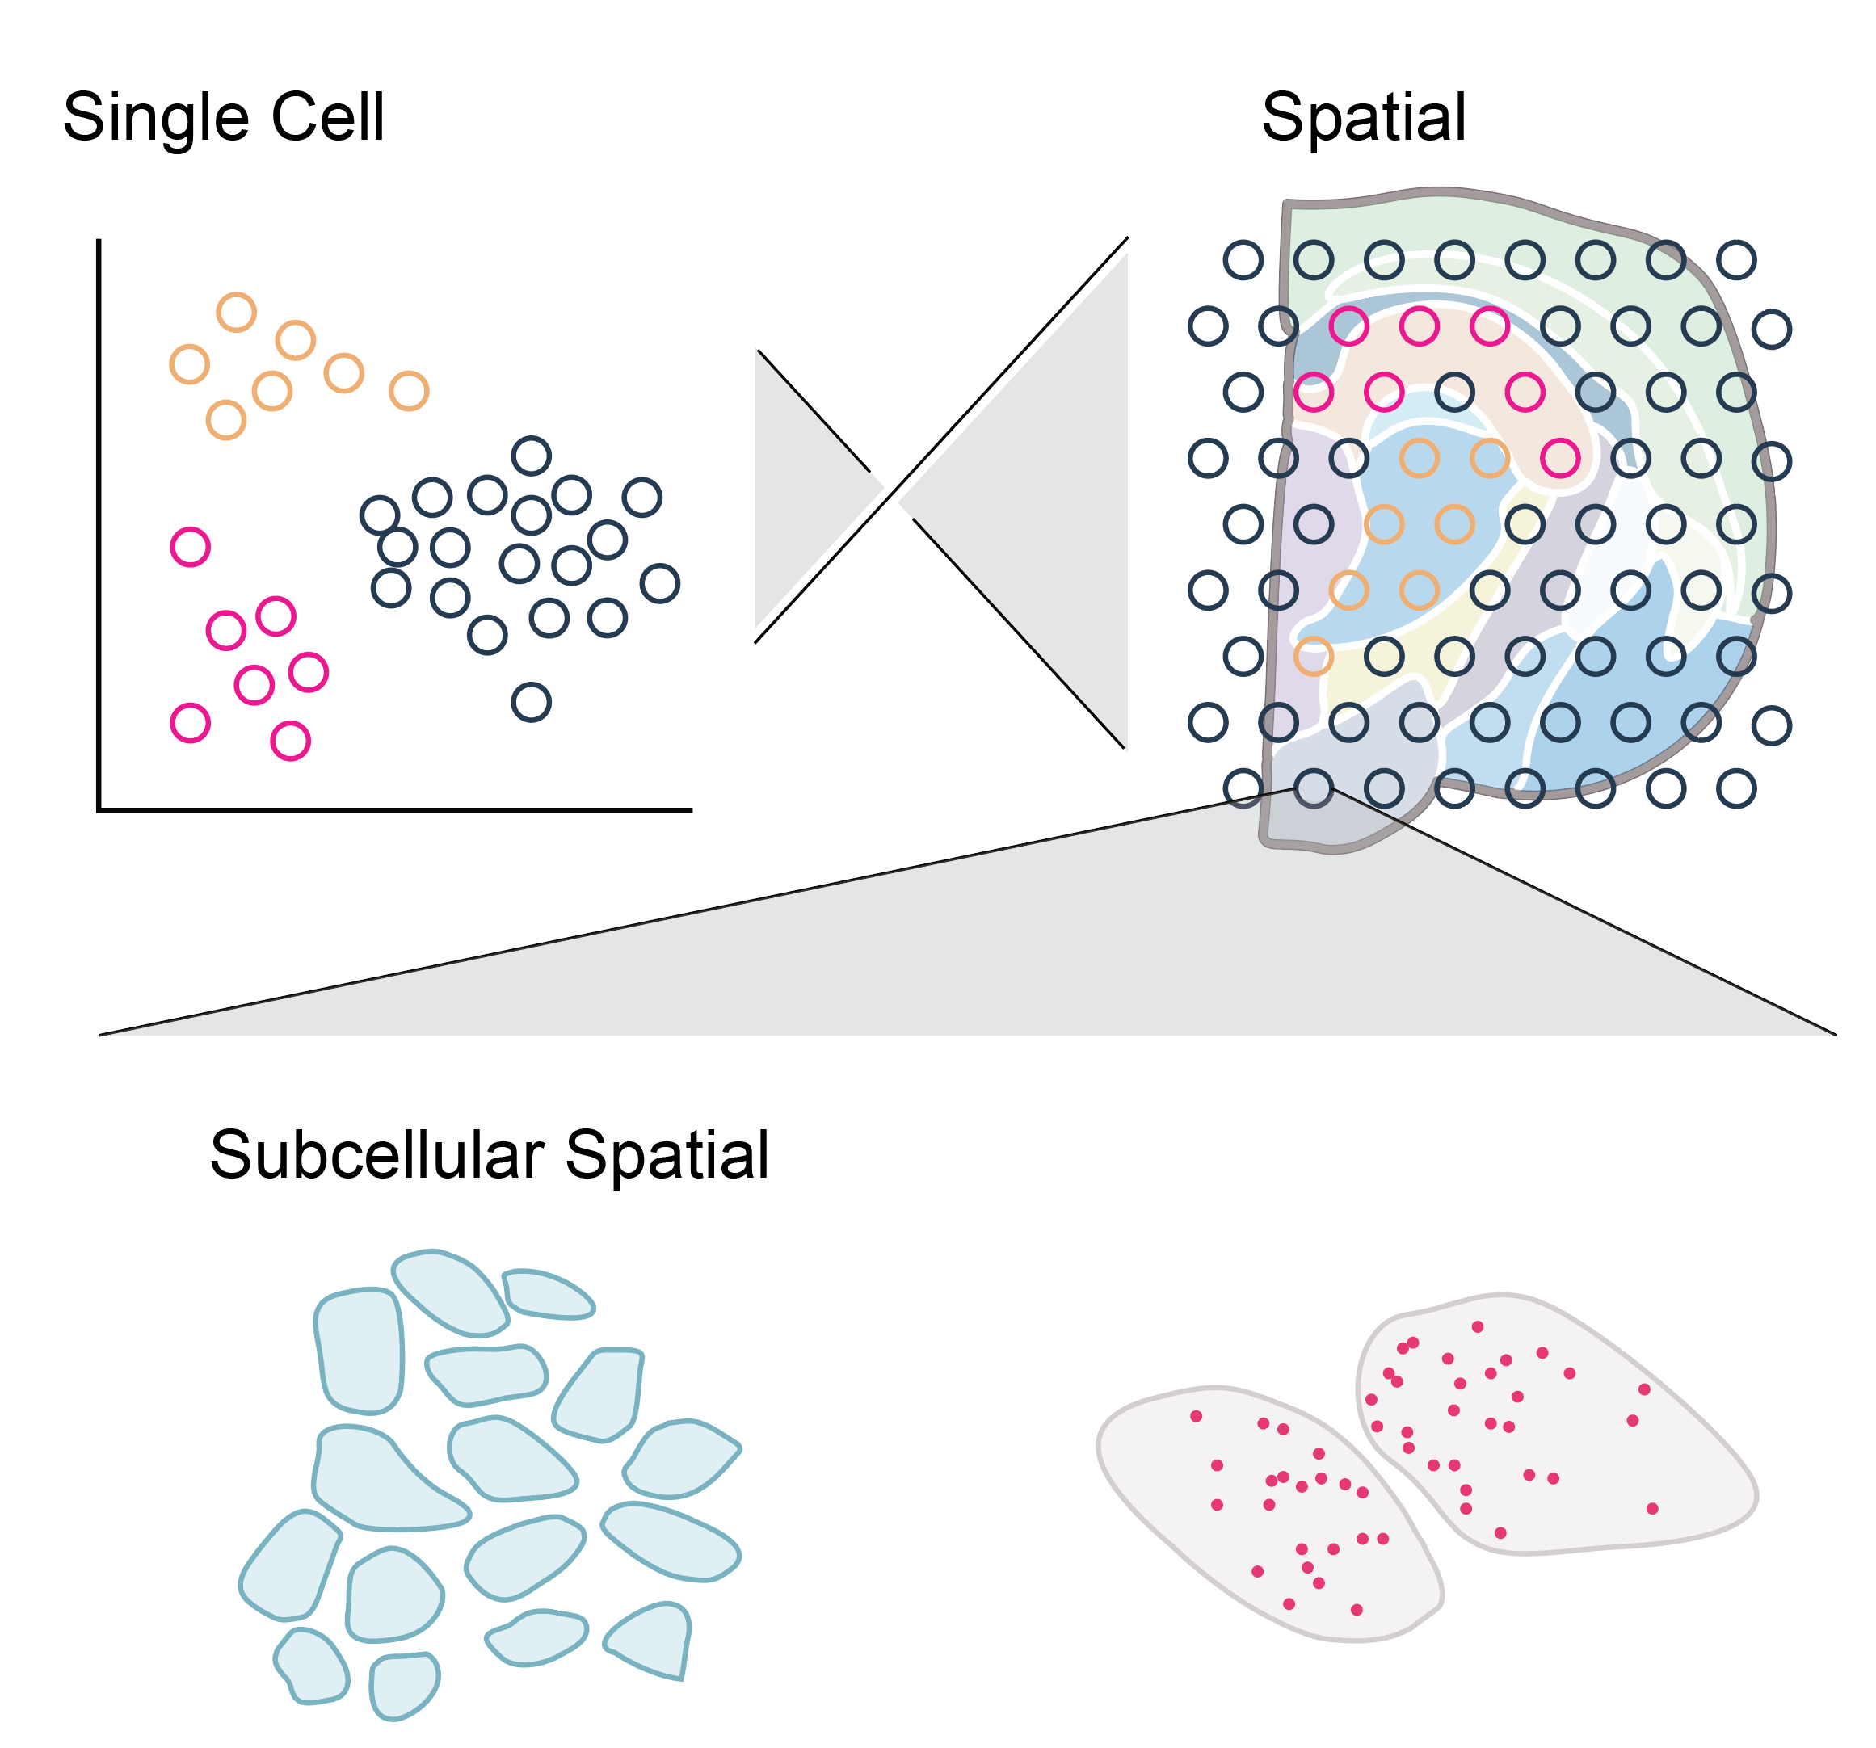
Mission
Need a tool that can:
Handle more complex spatial datasets
Generalizable and agnostic of spatial assay
Flexible across scale and feature modality
Natively work with subcellular information that is split into spatial units and feature types
Unit of study
Features

Slide 4
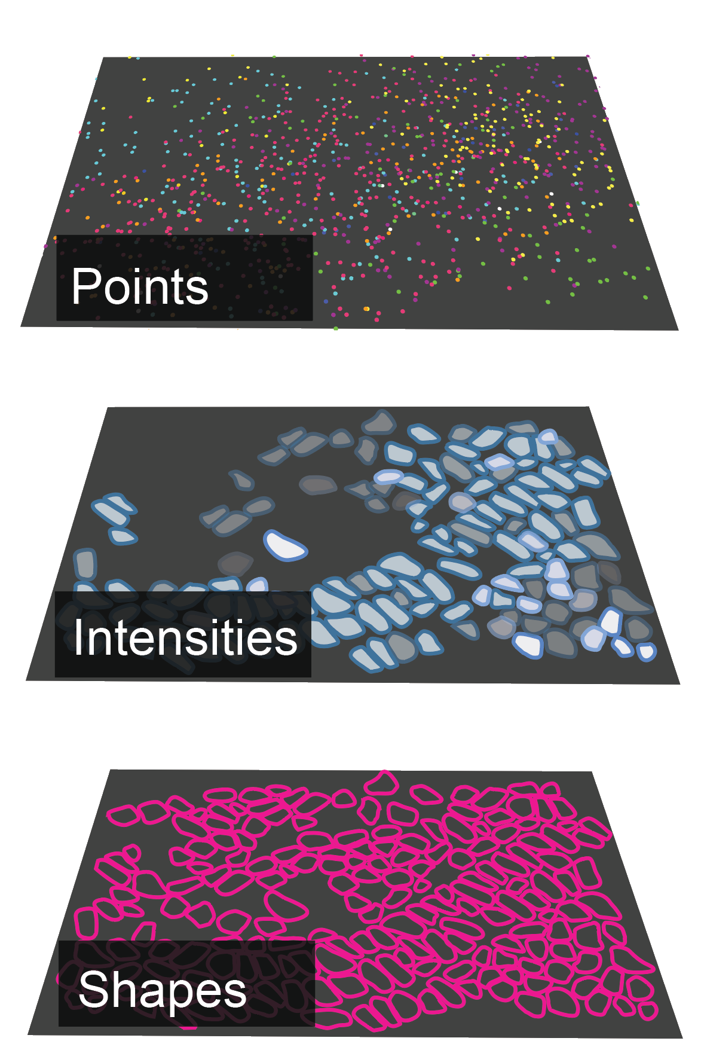
Spatial Datatypes
Input Types
Function
Feature_ID, x, y
createGiottoPoints()
Images
Tiff/ome-tiff
createGiottoLargeImage()
Vertex list
Poly_1, x, y
Poly_2, x, y
…
Mask image
geojson
createGiottoPolygon()
Notes:
Introduced 3 data types into Giotto

Slide 5
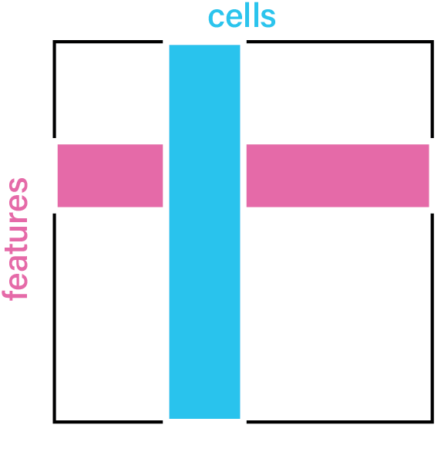
Aggregation
Count
calculateOverlap()
overlapToMatrix()
Intensity sum
Notes:
You have your poly annotations and features, now what, what is the unit of your study
Key concept with natively using subcellular data is aggregation -> expression matrix -> downstream
Now that spatial unit and feature data are separate, you have a lot of freedom over how to combine the two

Slide 6
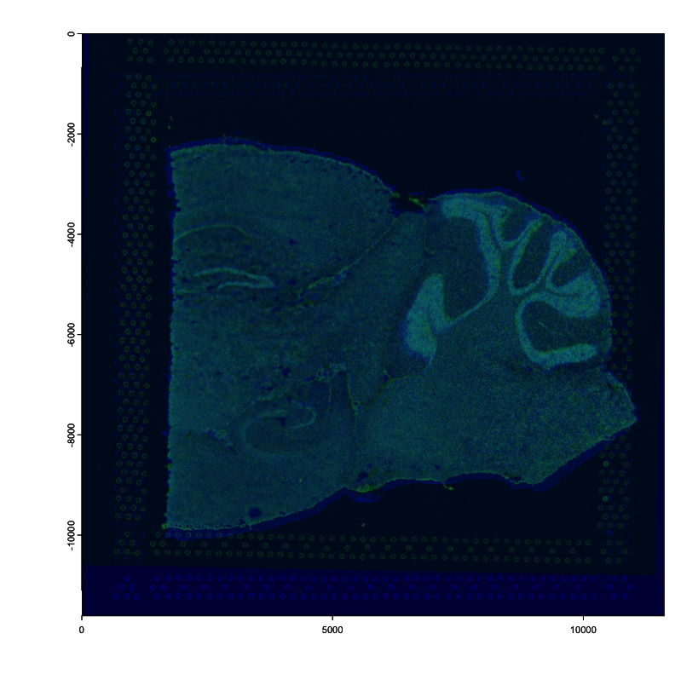
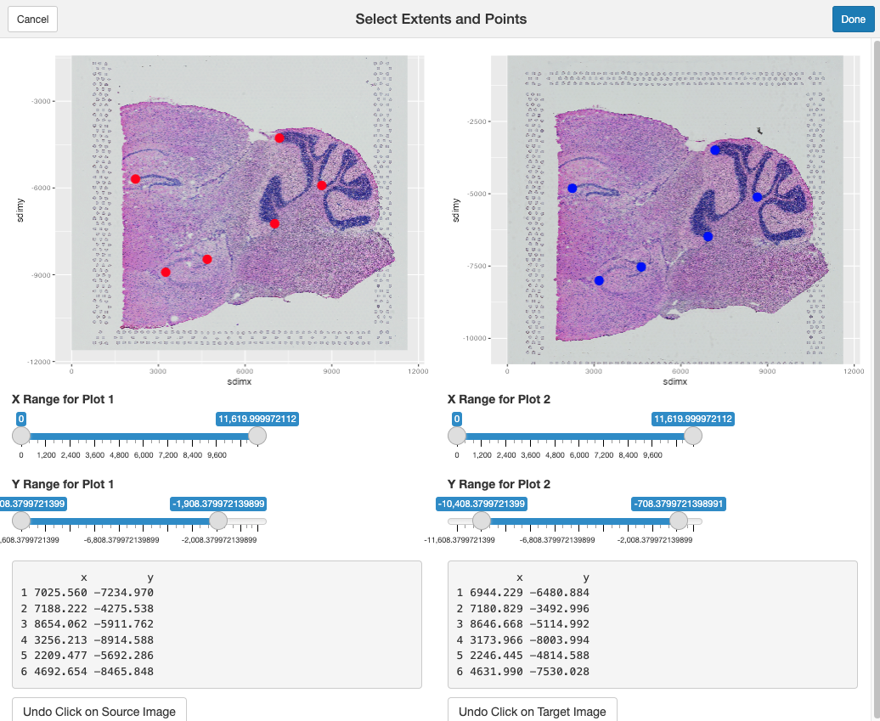
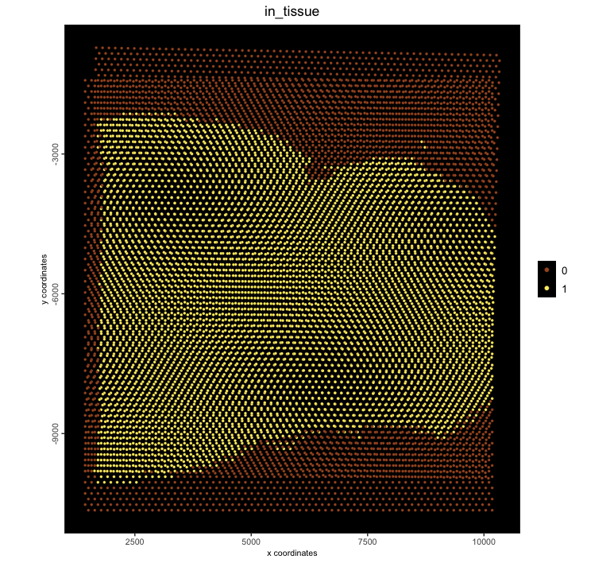
Spatial Wrangling
Notes:
Also focused on spatial wrangling, how do you make sure all your data is properly lined up.
Compatibility of our spatial objects with rigid and affine transformations
Simplifies setting up an analysis in space. Also allows us to simply calculate and apply affine registrations

Slide 7
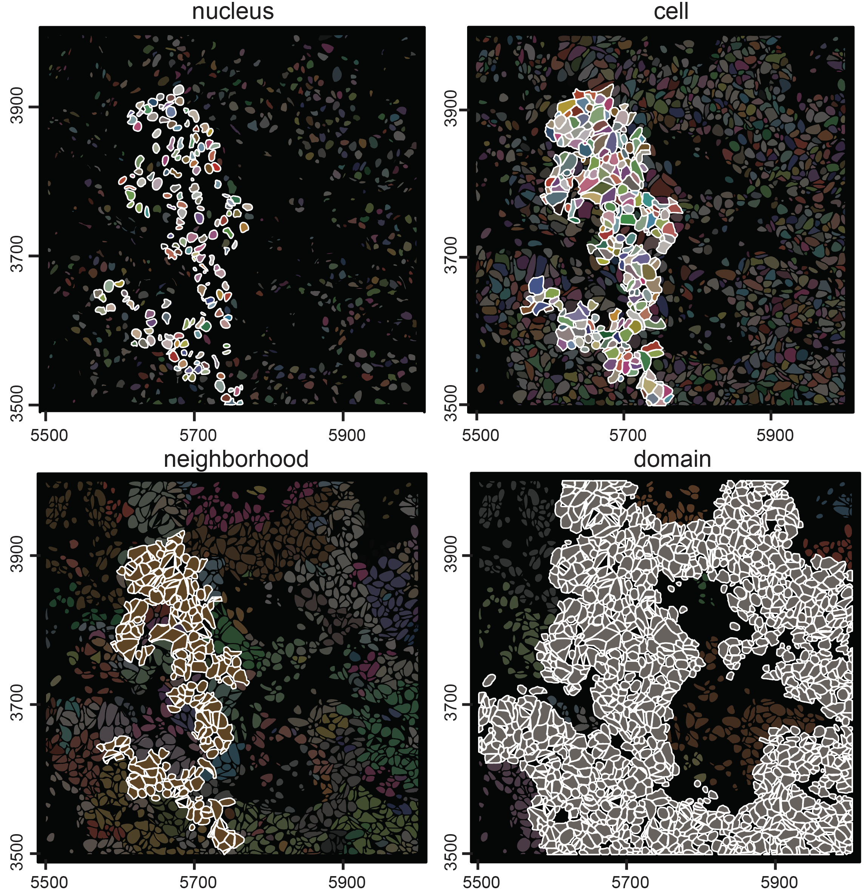
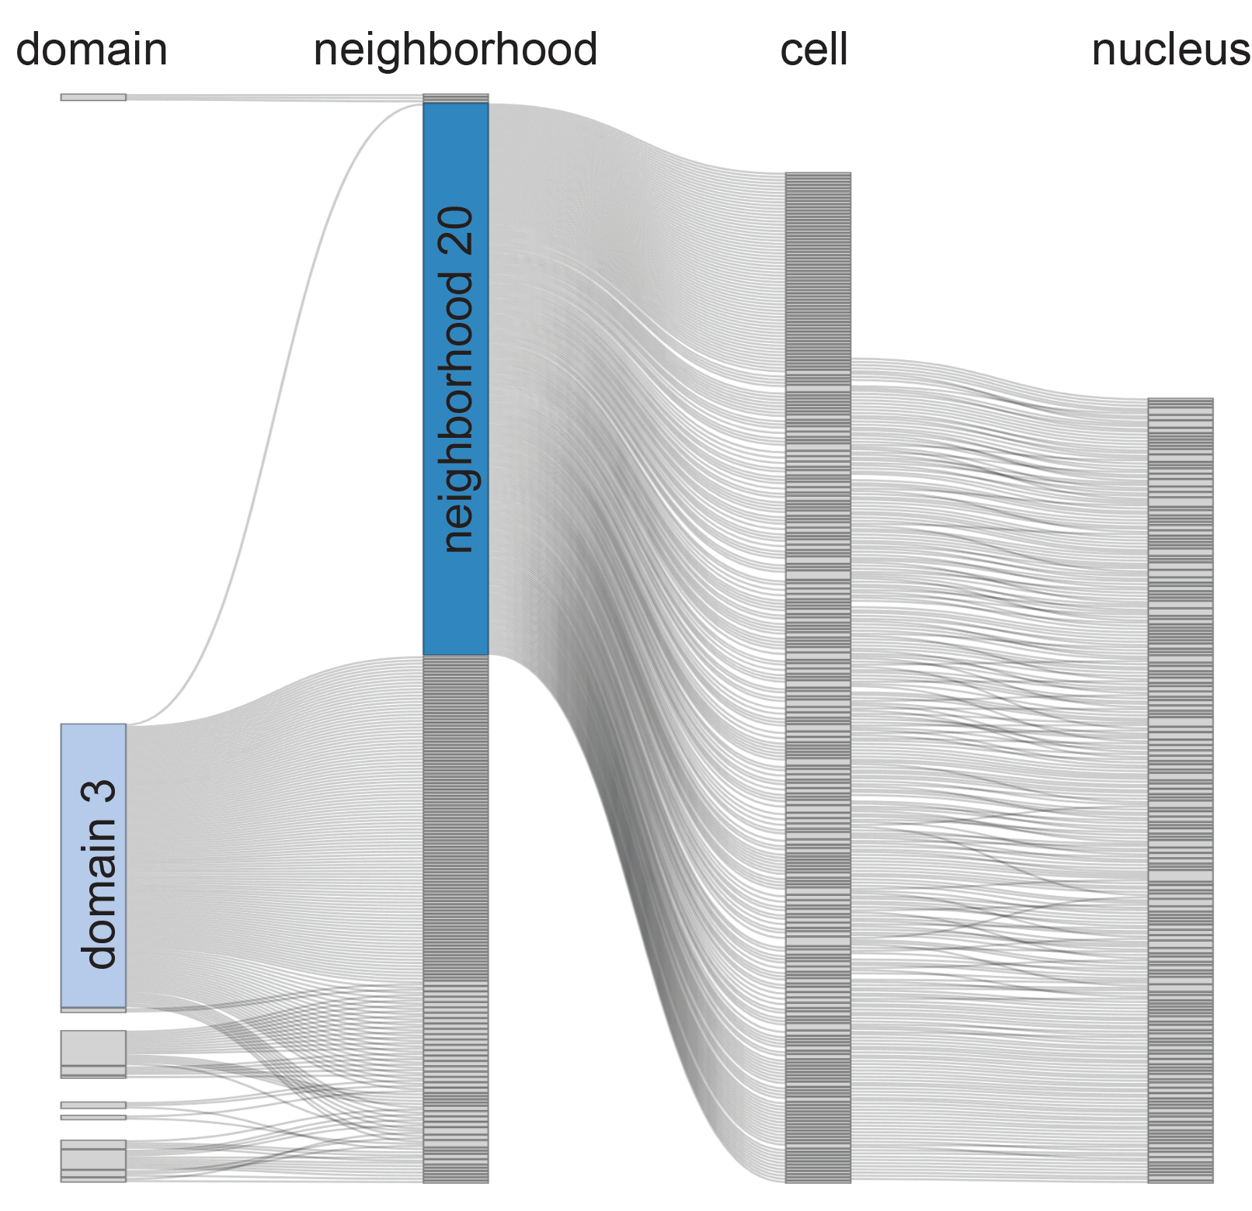
Spatial Relationships
spatQuery() # across polygon sets in gobject
relate() # single geom objects
Notes:
Spatial data also comes with spatial relationships. We offer the `relate()` function that allows you to test for particular spatial relationships like contained or intersects etc
Excerpt from the paper showing how you can use this function to drill down across multiple levels of polygon annotations.

Slide 8
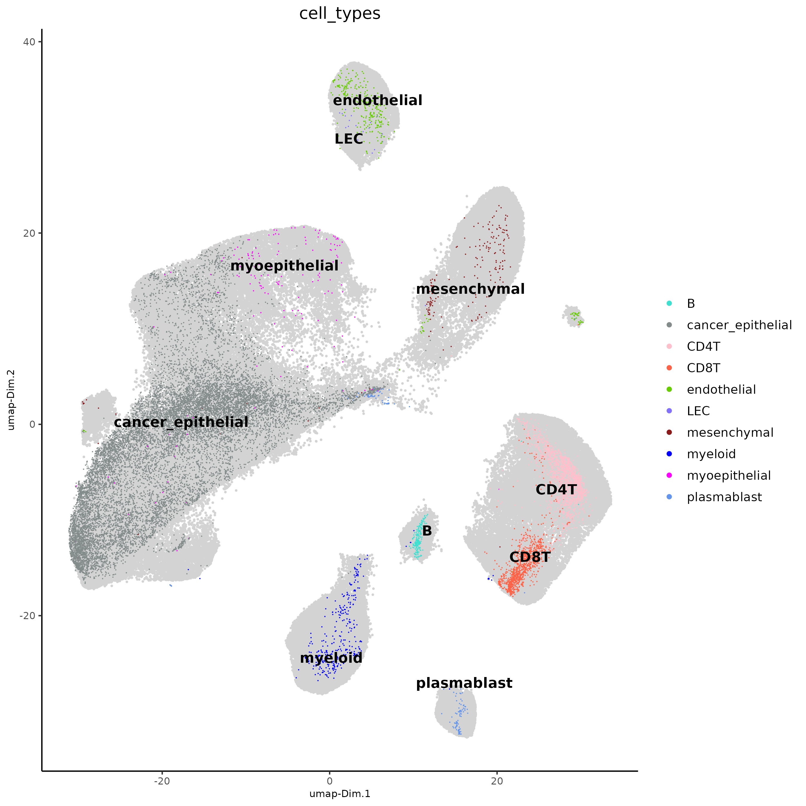
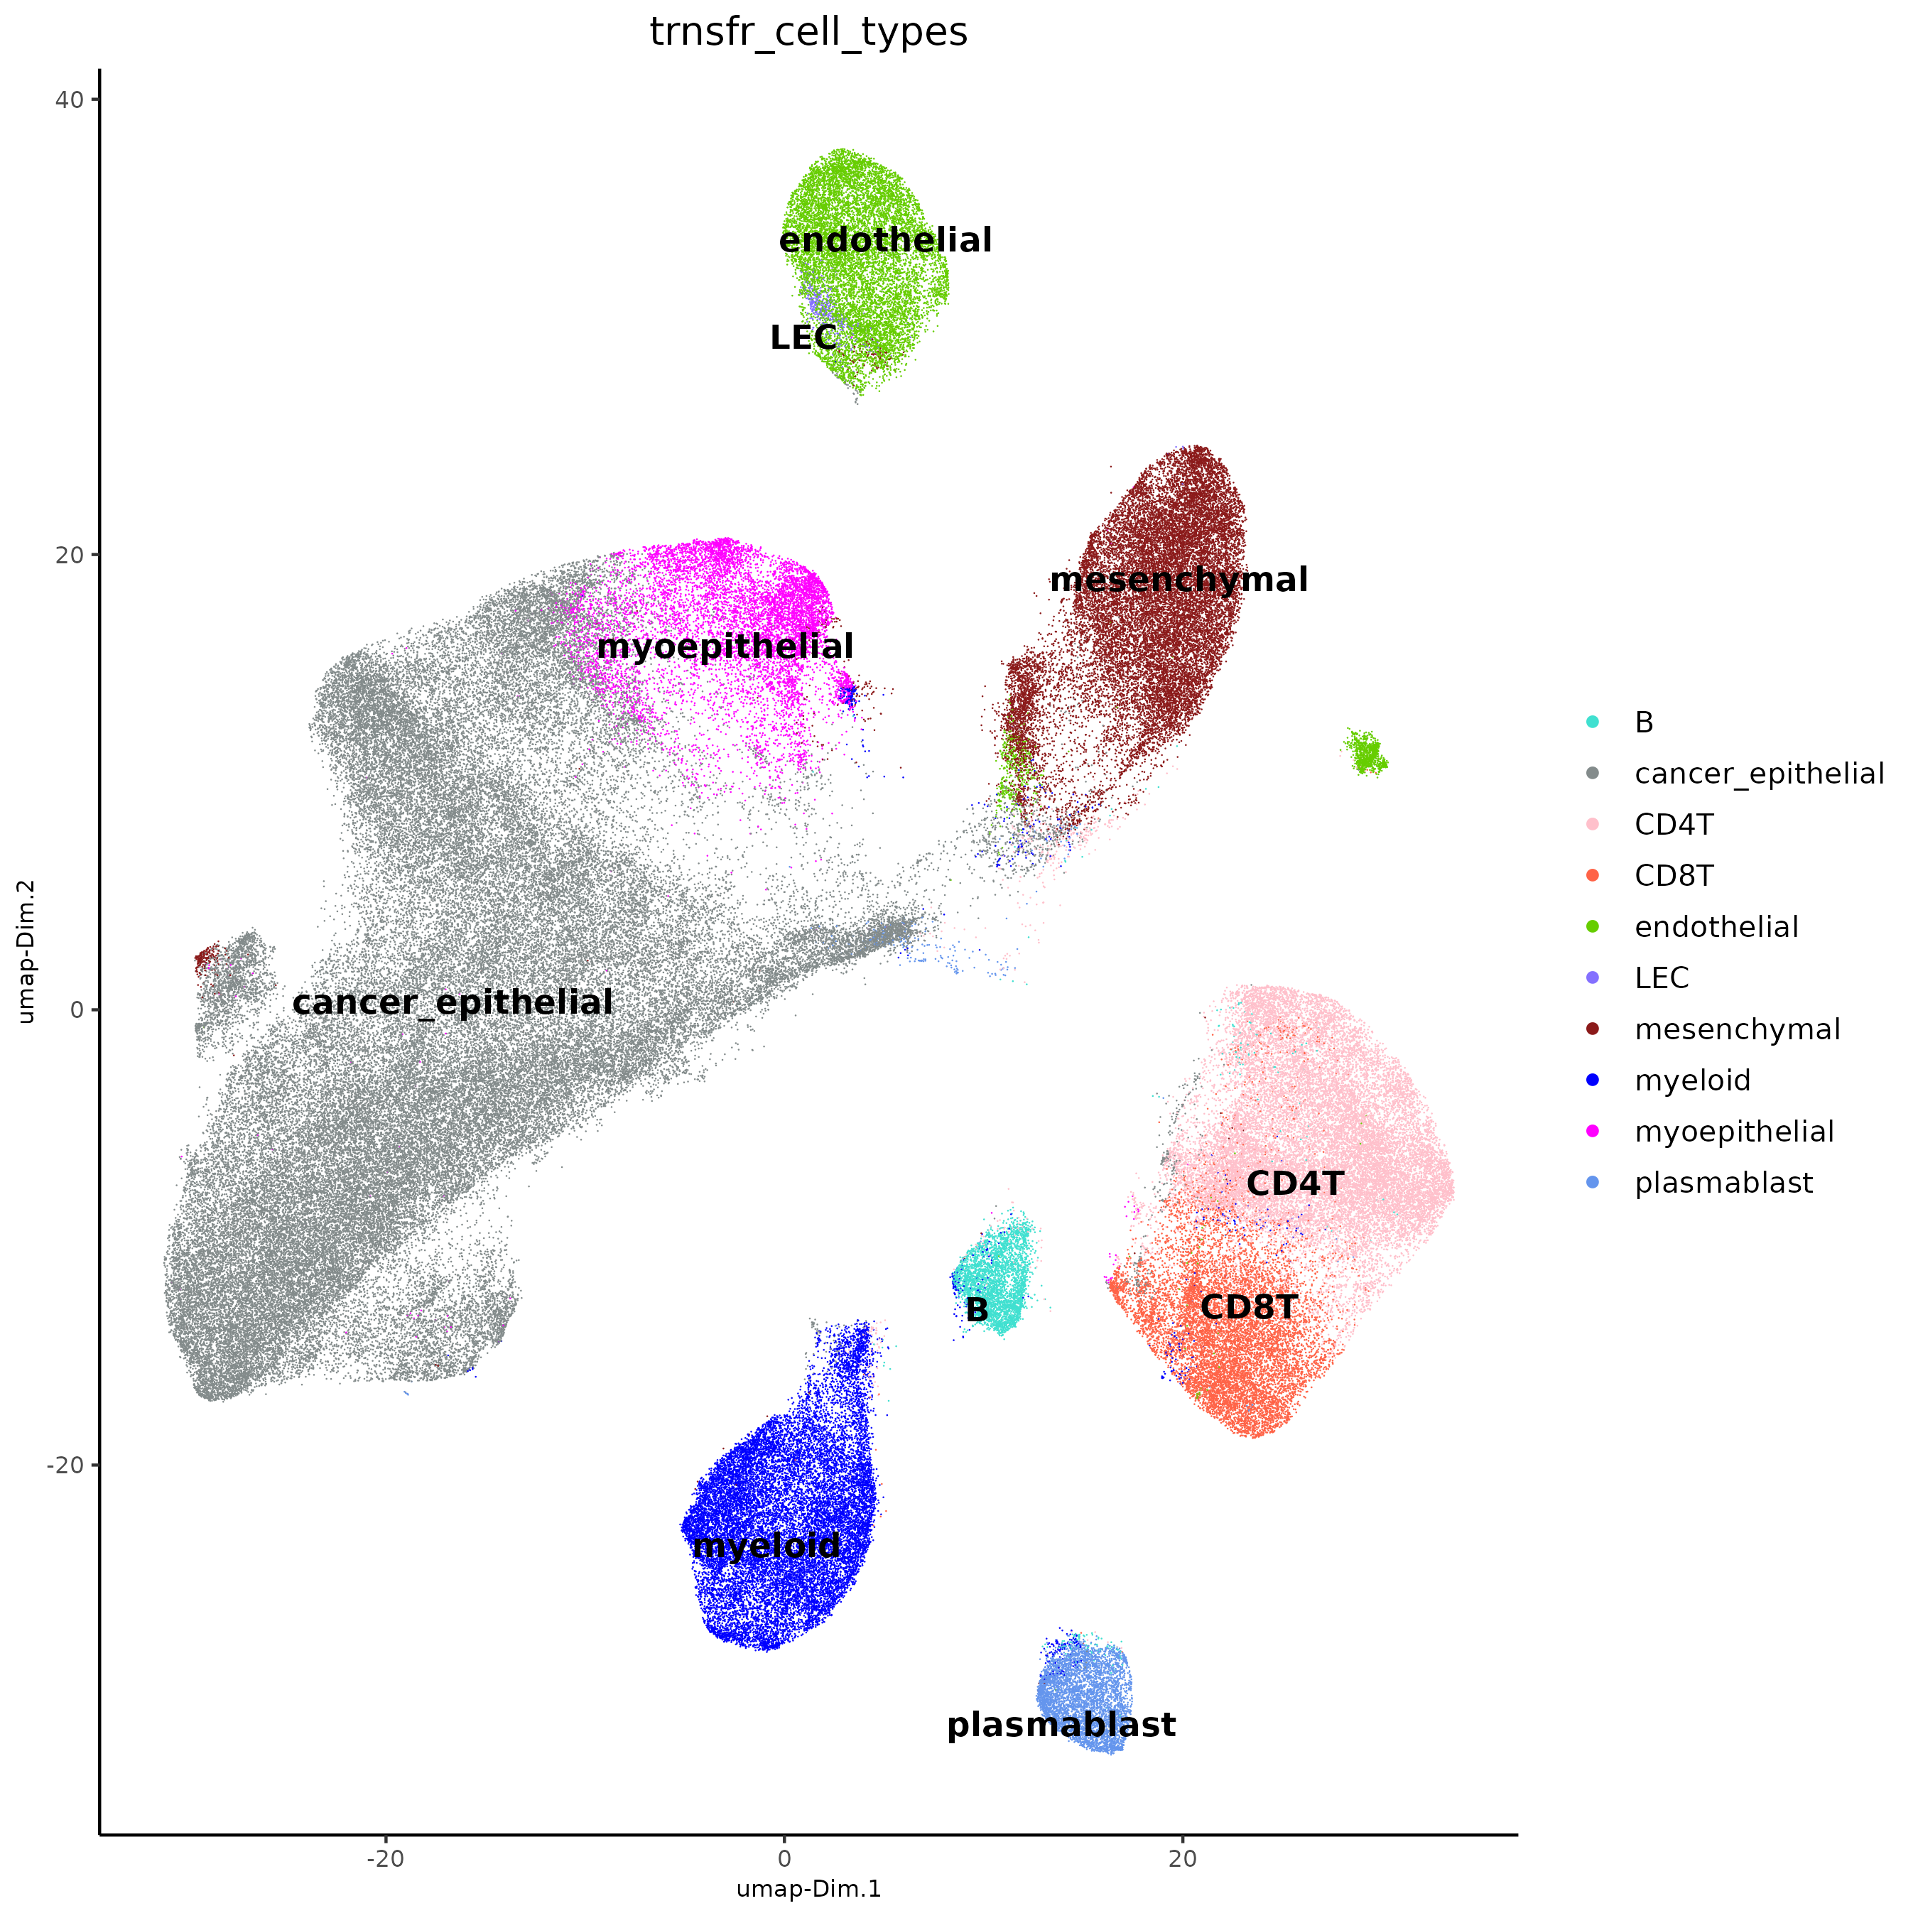
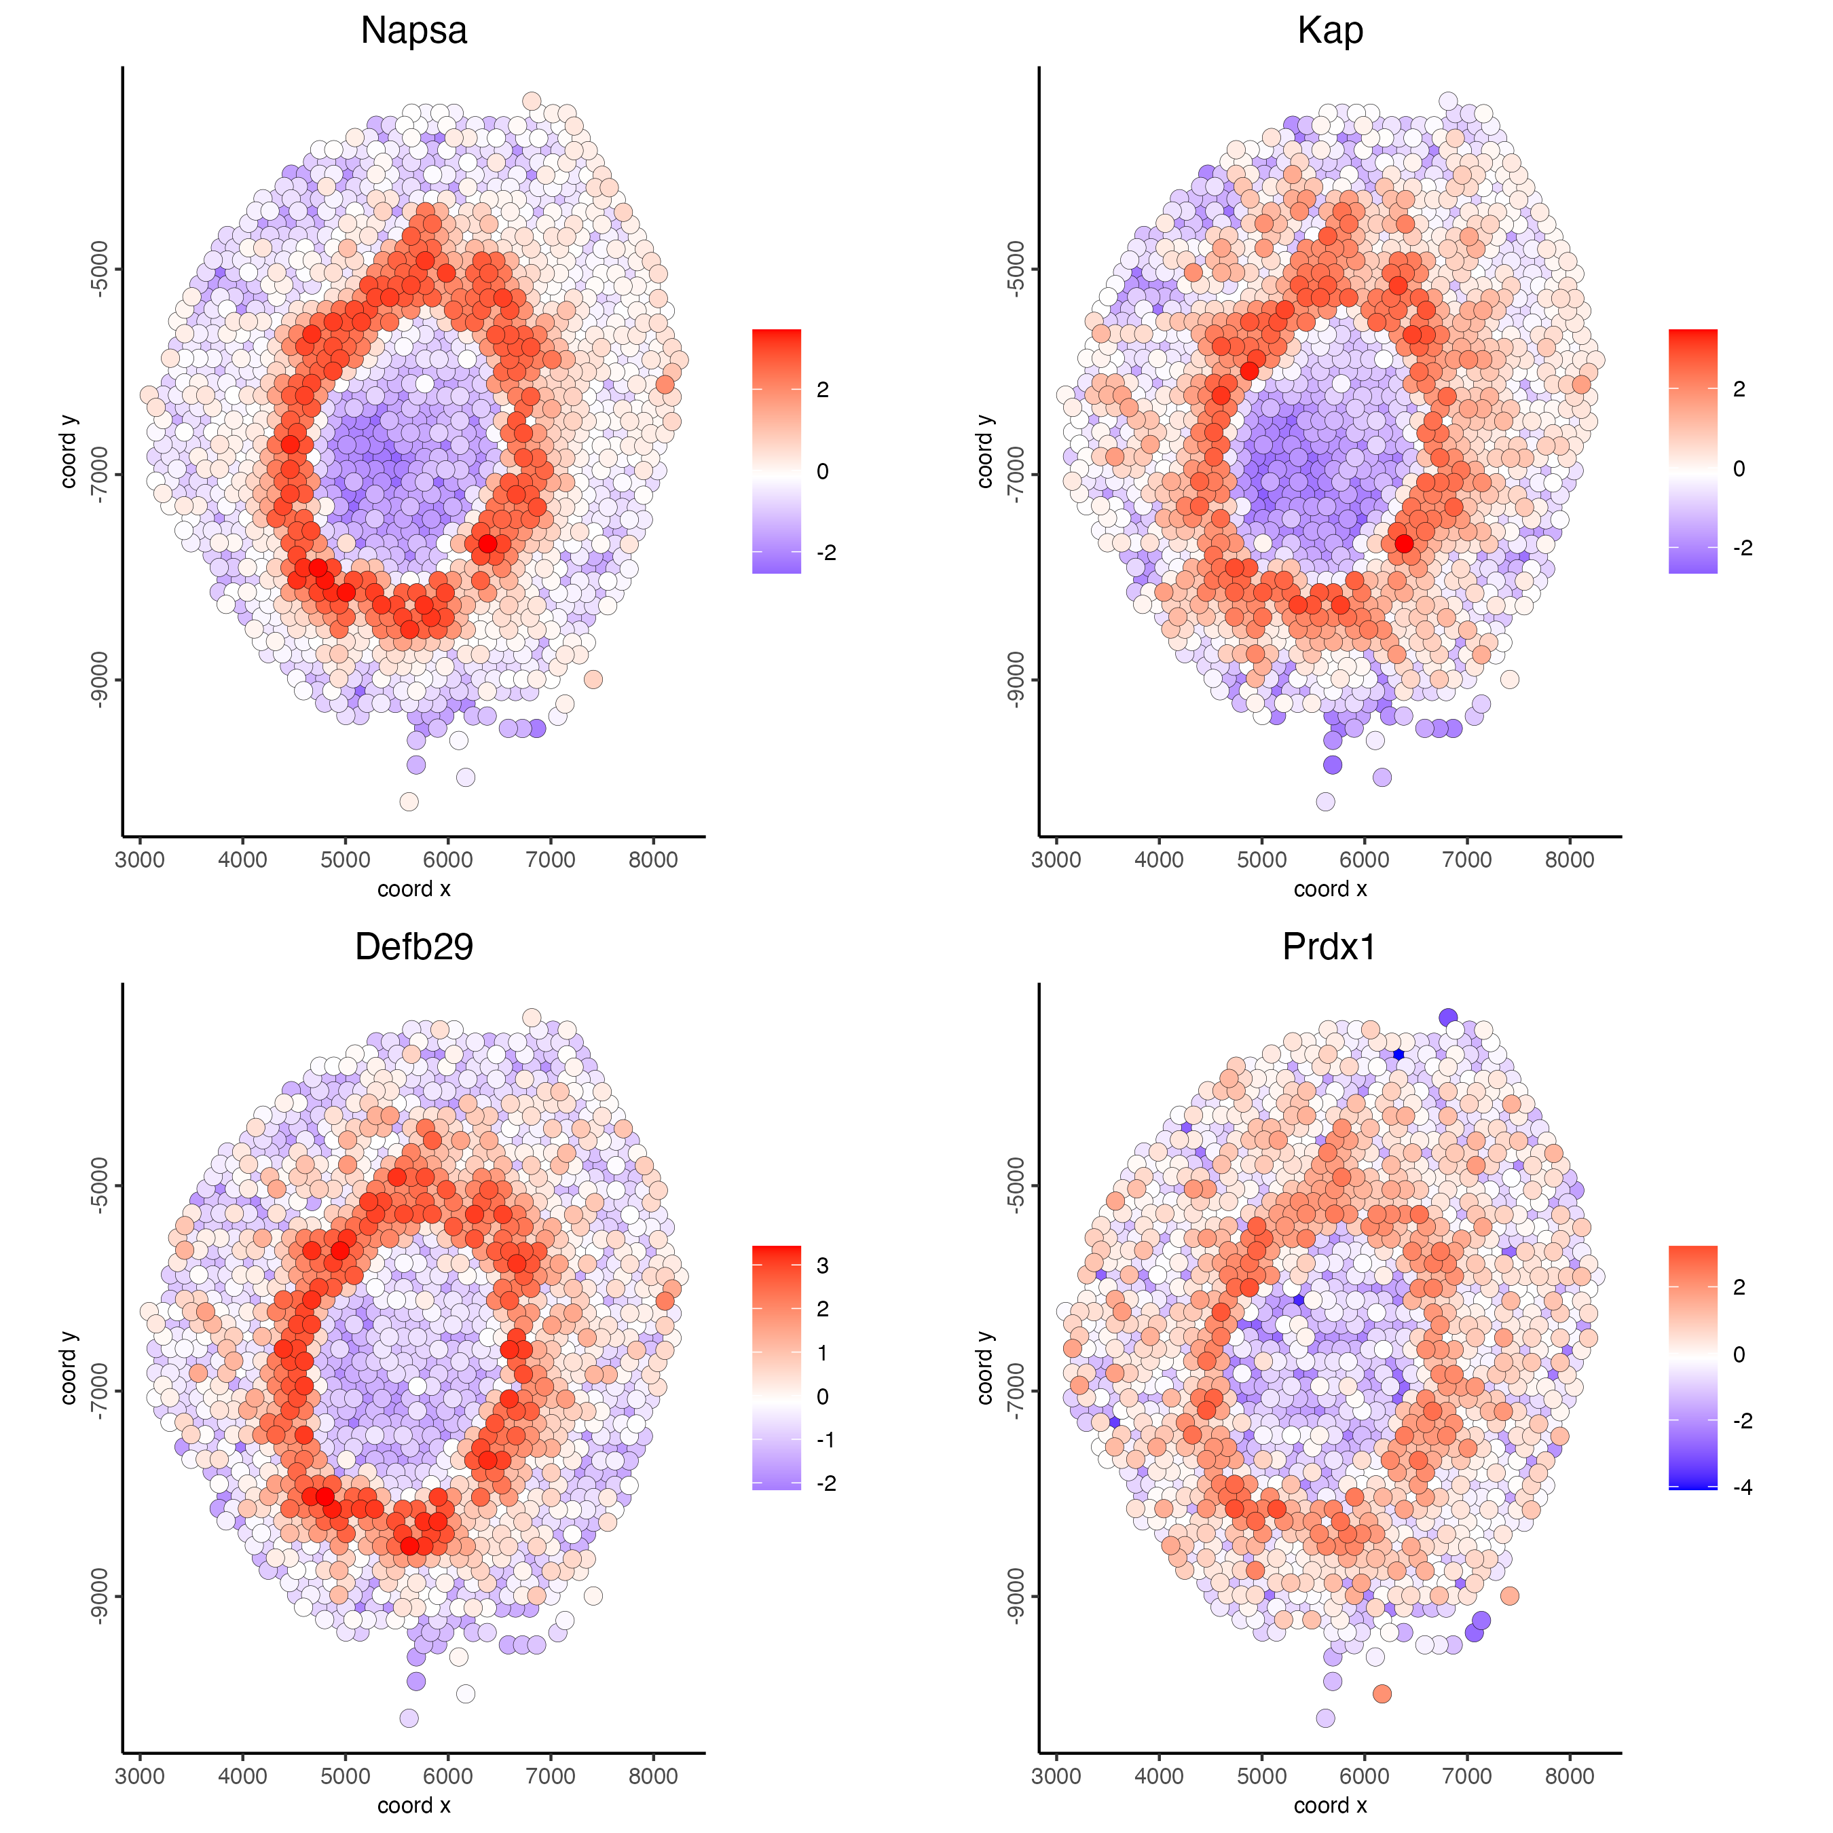
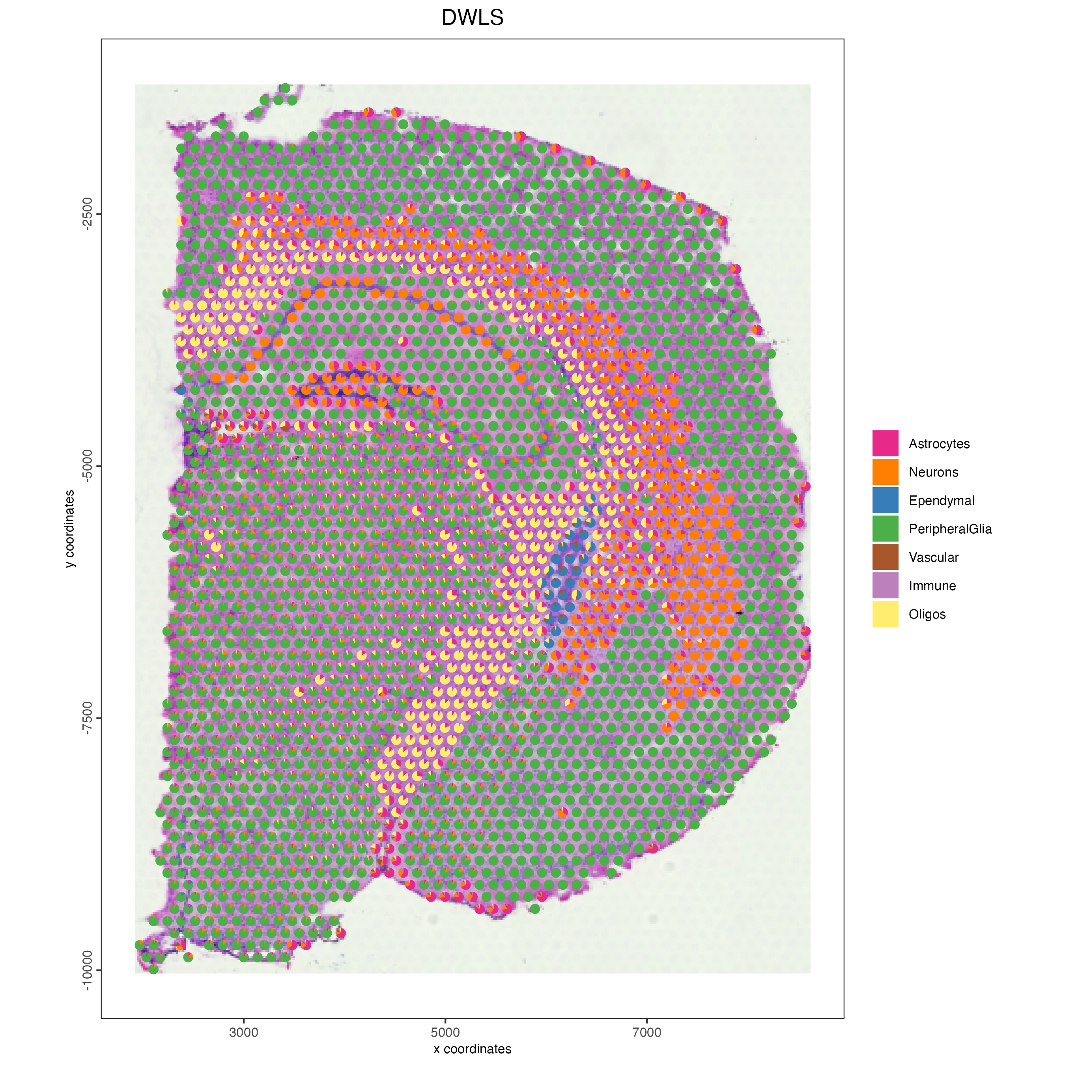
Applications
scRNA-seq Label Transfer
Niche Analysis
Binning
Spatial Co-Expression
Deconvolution
Cell Cell Communication
Is there feature enrichment…
exprCellCellcom()
spatCellCellcom()
With particular celltype pairs?
Only when a pair is spatially proximal?
giottosuite.com
Notes:
Some additional examples of Giotto’s functionalities that you can see further examples of on the website

Slide 9
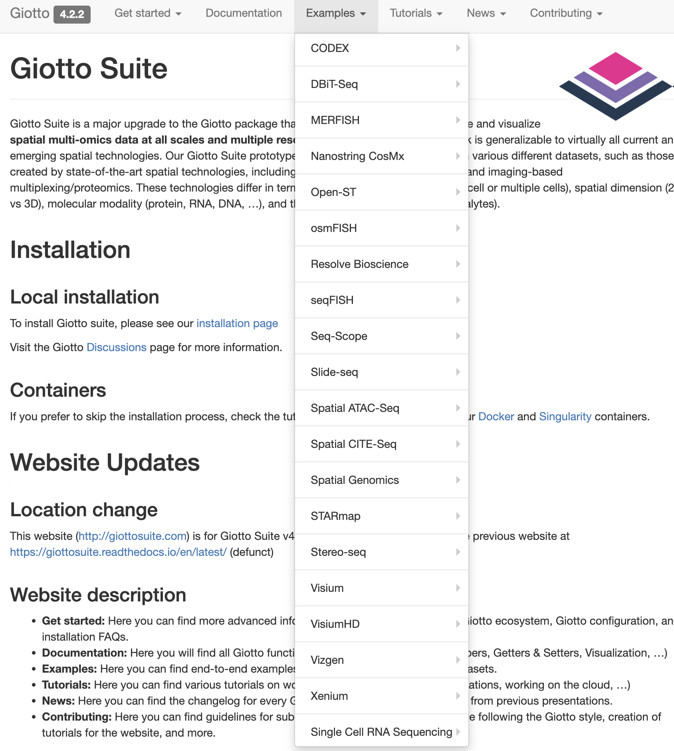
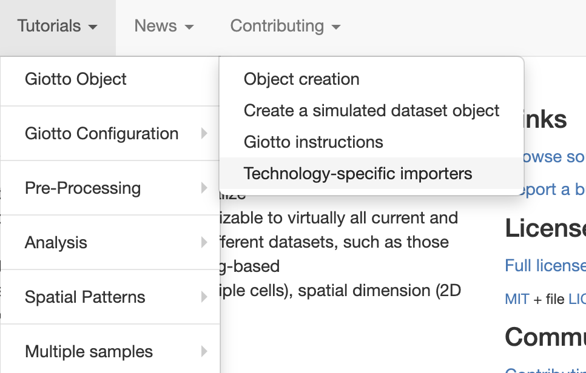
Import Convenience Functions

Slide 10
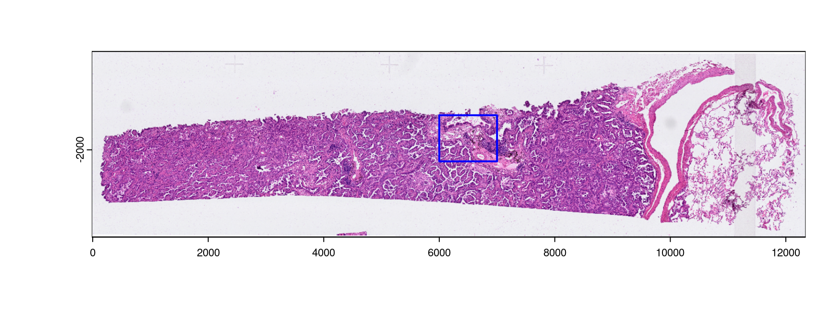
Demo
https://github.com/jiajic/ST_working_group_2025/
Xenium FFPE Lung Cancer
In order to speed up the steps of the demo and make it locally runnable, we will work a subset of the dataset.
- Full: -16.039, 12342.984, -3511.515, -294.455 (xmin, xmax, ymin, ymax)
- Mini: 6000, 7000, -2200, -1400 (xmin, xmax, ymin, ymax)
Notes:
Demo with early Xenium V2 output dataset

Slide 11
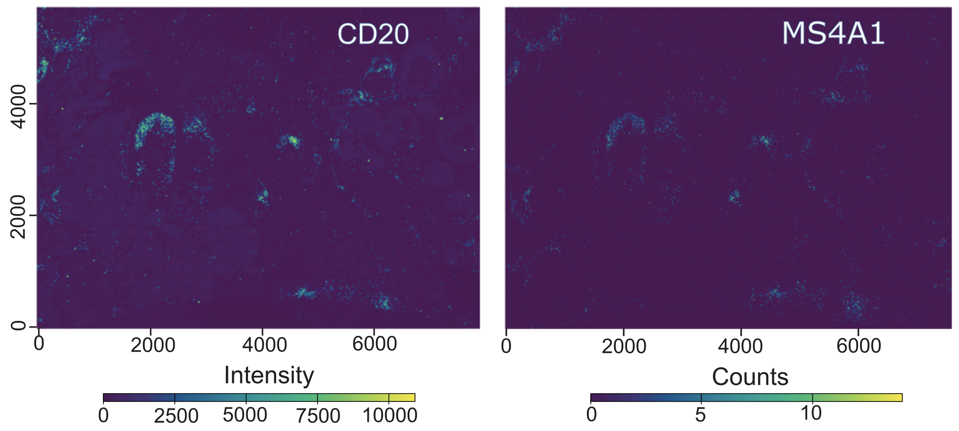
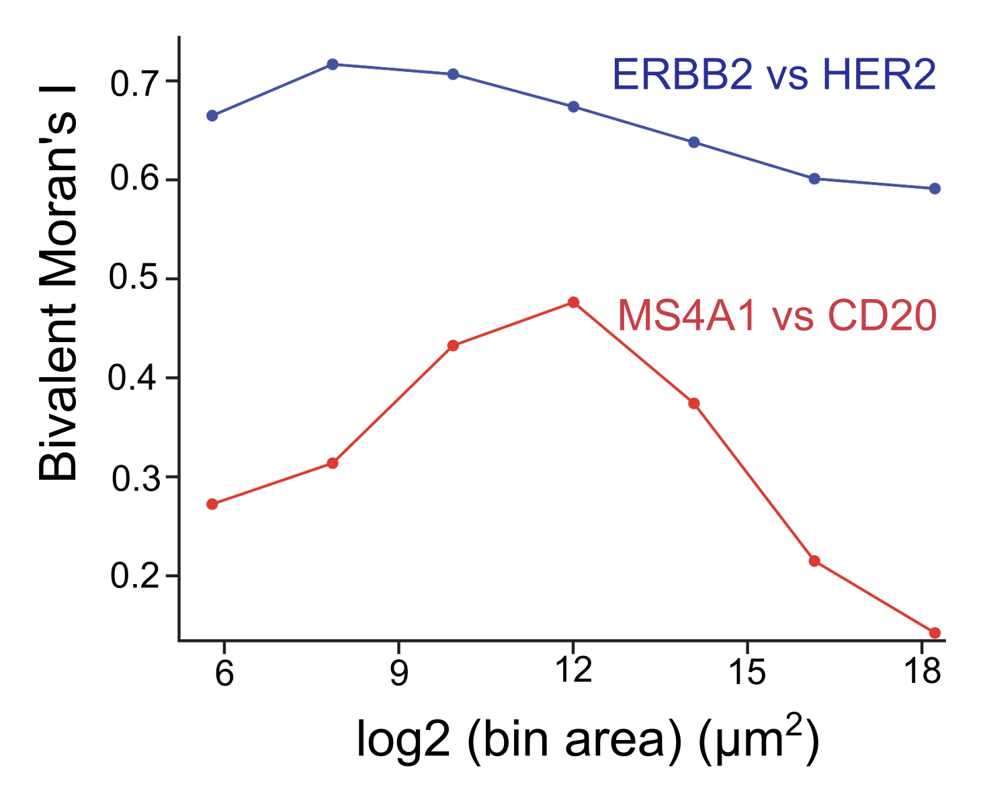
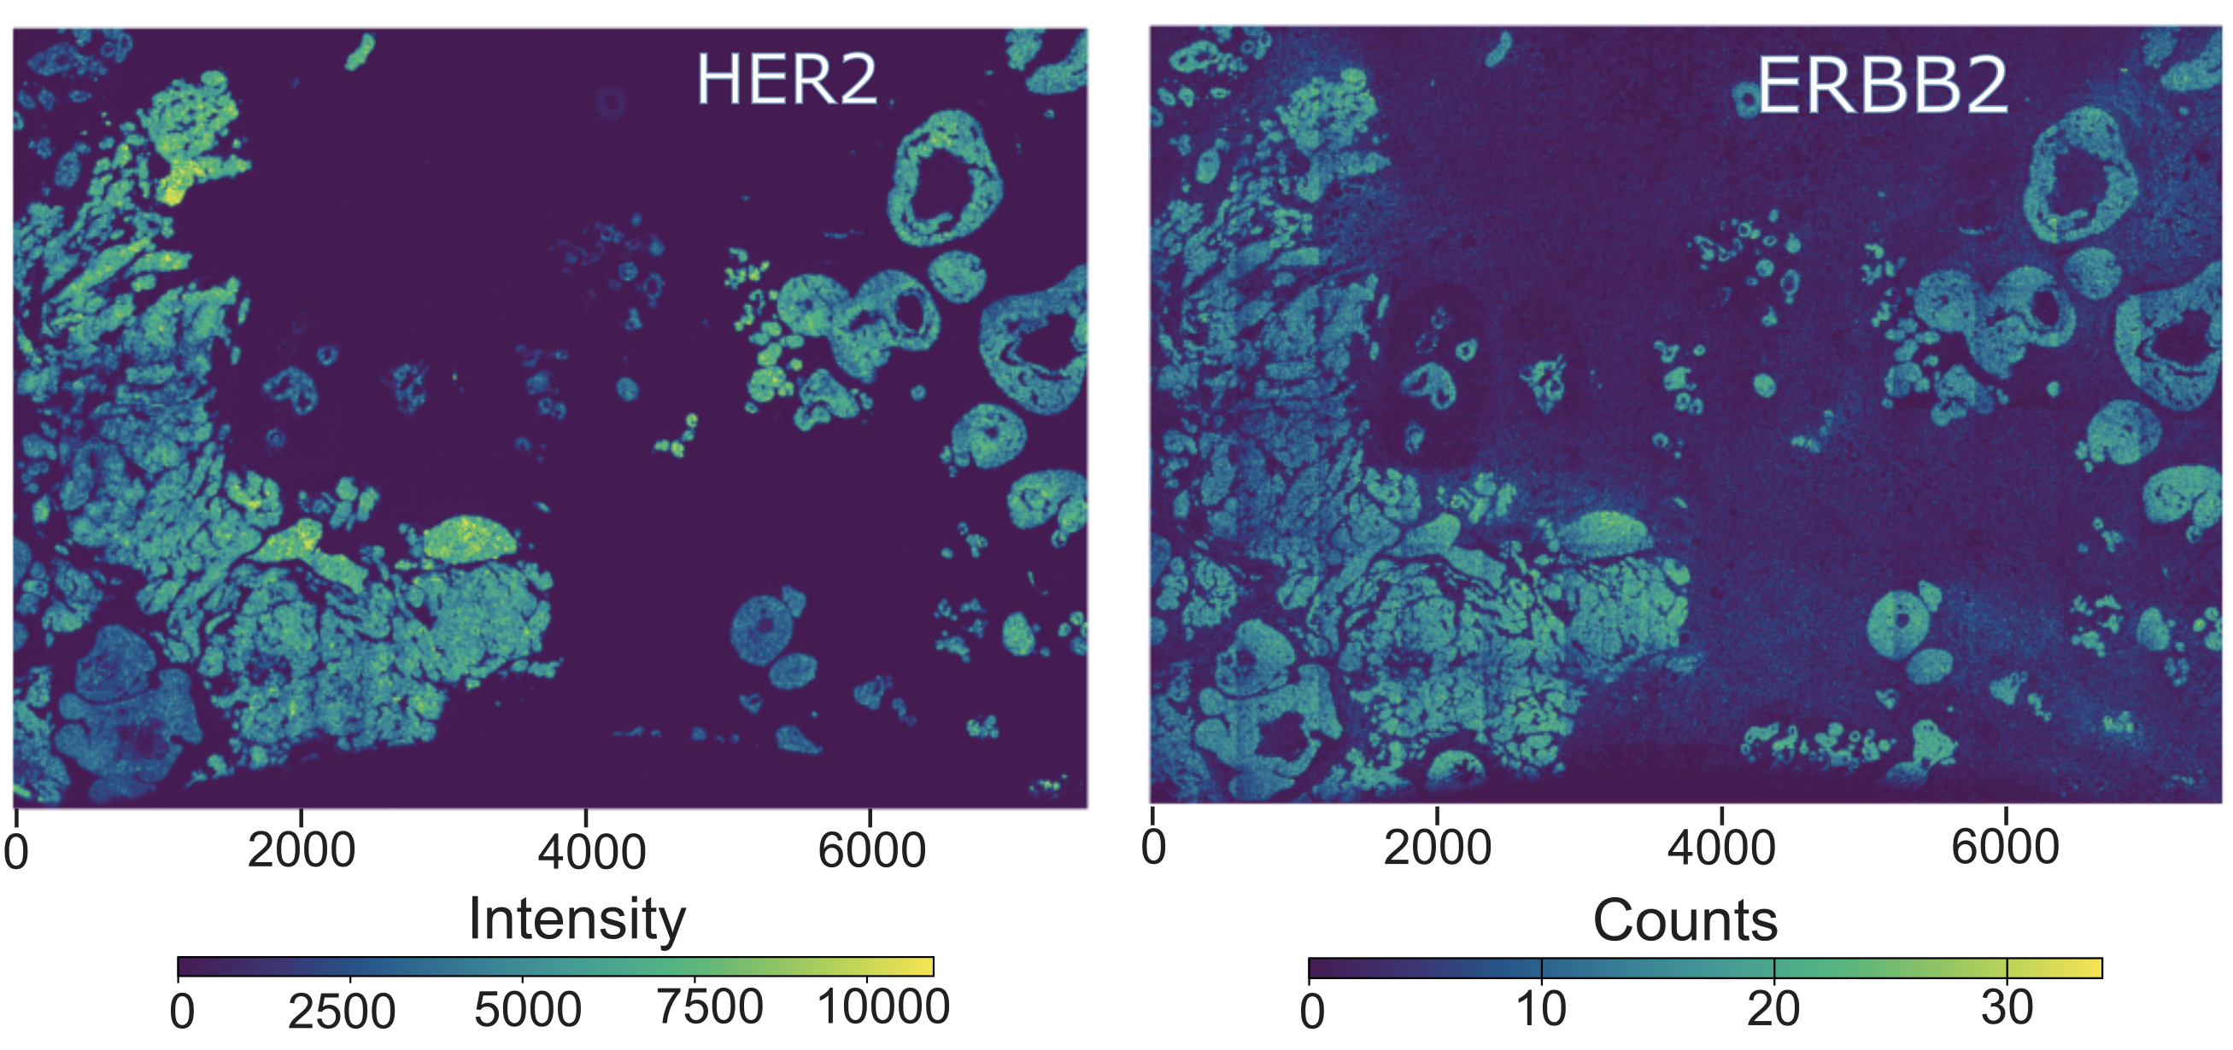
Spatial Binning
polyStamp()
tessellate()

Slide 12
Neighborhood Composition
calculateLabelProportions()
A Cell1
A Cell2
B Cell3
A Cell4
… …
C CellN
table
network
polygon
Group composition

Slide 13
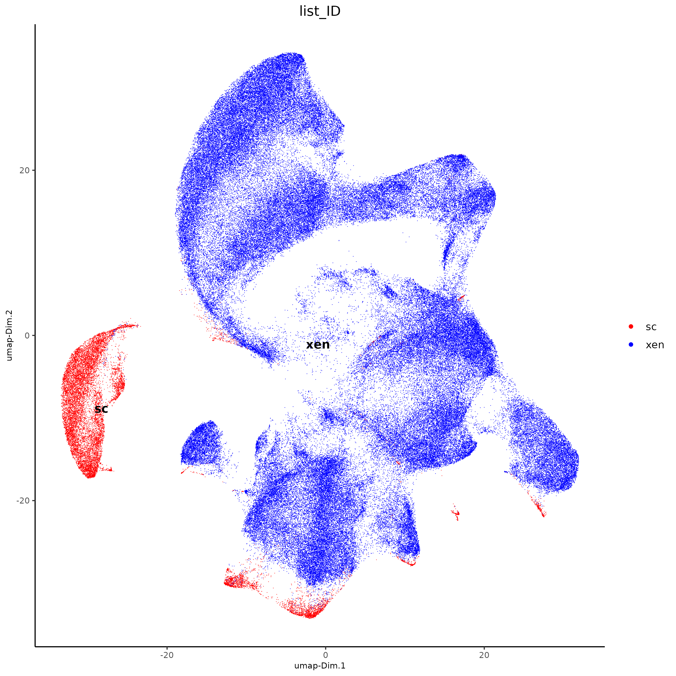
Label Transfer
Transfer labels from one subset of cells to another or from one giotto object to another

